Slide 1


G20 ( organization) website
Name: Kuldeep jagdishbhai rathod
ROLL NO:172
ENROLLMENT NO:21002170110155
BATCH: A5
BRANCH:CE

Slide 2
Why g20 ?
Sometimes there things we saw but can’t understand properly.
As we know this time g20 ‘s host country is india so people know what is actually g20 and how it’s works.
So this website give you brief information about g20 and you can understand it very well.
Basically I make this by using bootstrap(40%) ,css(40%),html(20%).

Slide 3
information
Basically I use html,css,bootstrap.
html-Body-used html as basic in like i create footer with html and another small tag .
Css-use css for making website more attractive like animation and hover .
Bootstrap-use bootstrap here for making navbar ,accordian ,grid and take many attributes of it
Files-for create this website I create 8 files .

Slide 4
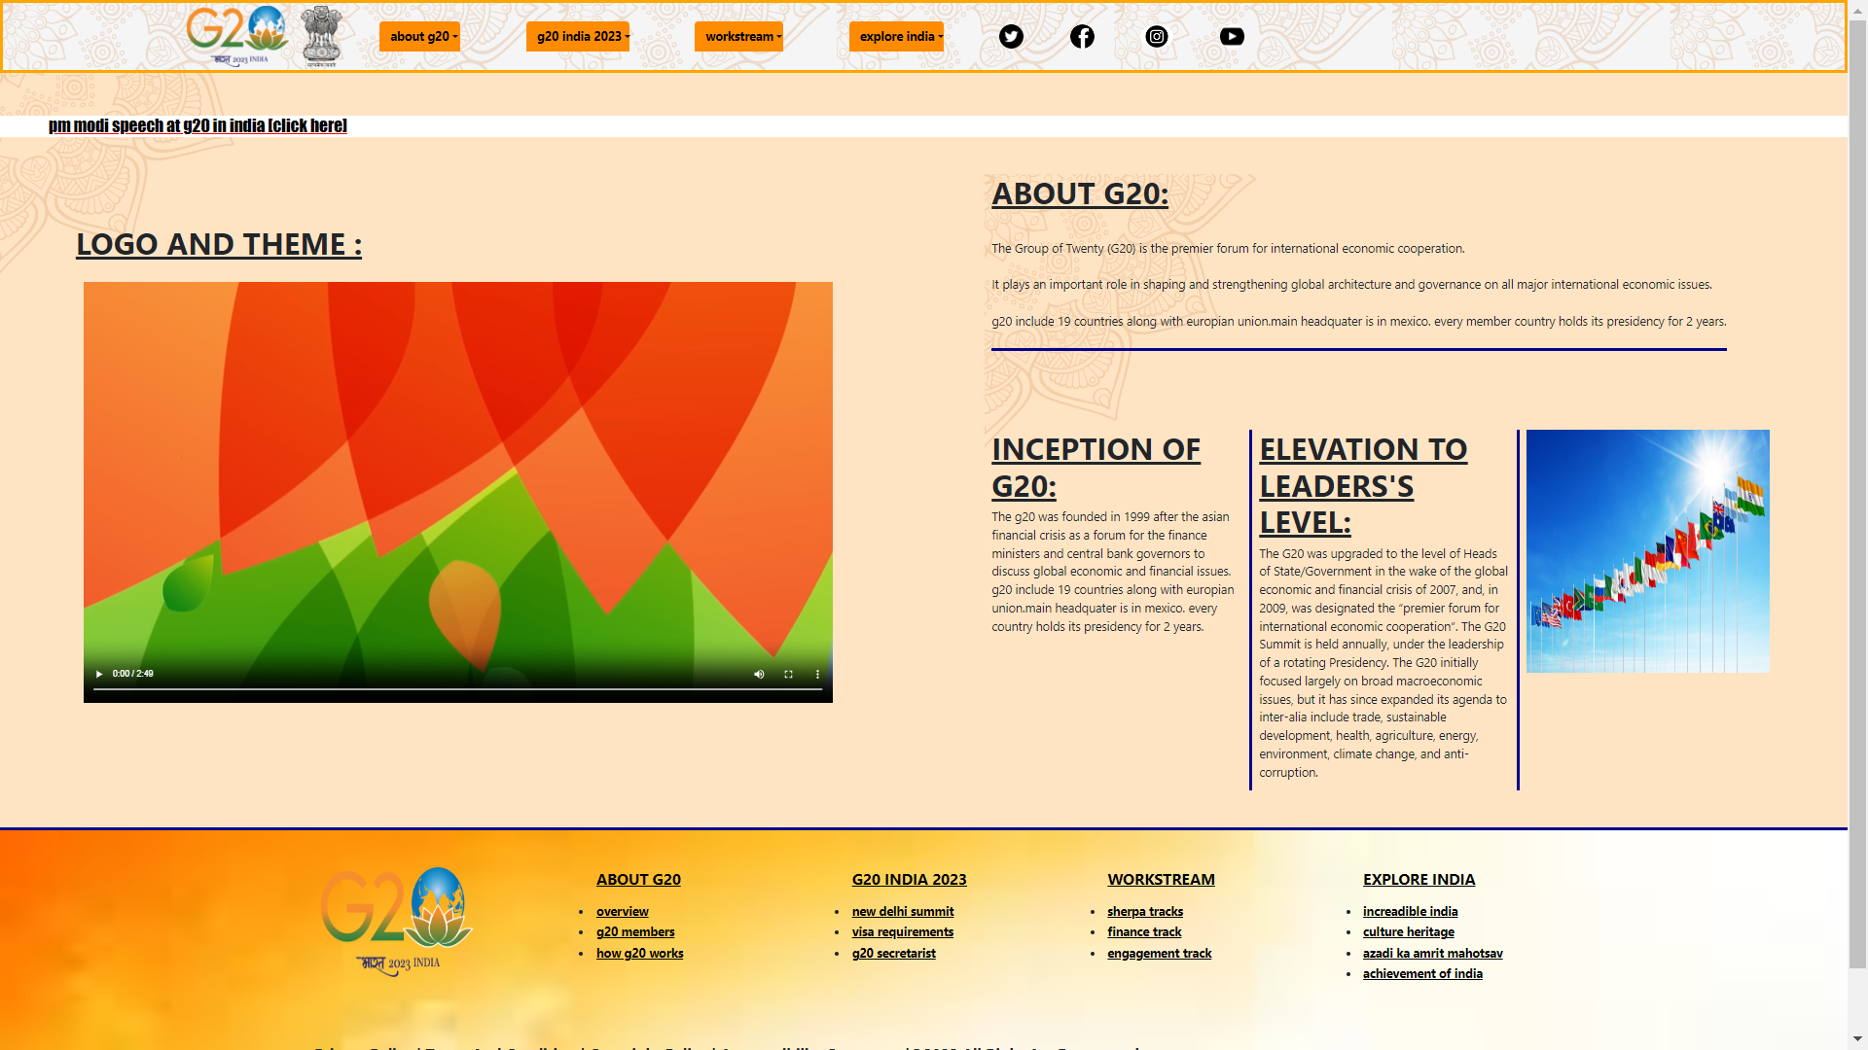
Snapshot of Home Page

Slide 5


